Slide 1
Designs in 2019 FPGA Design Contest

Slide 2
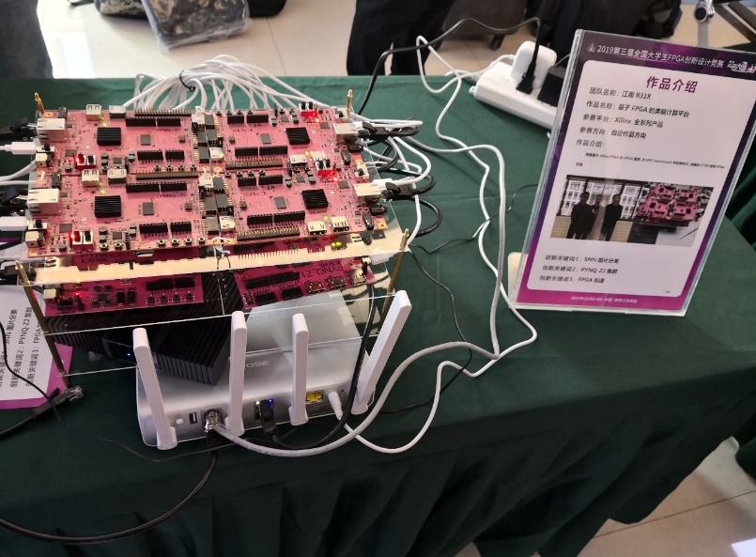
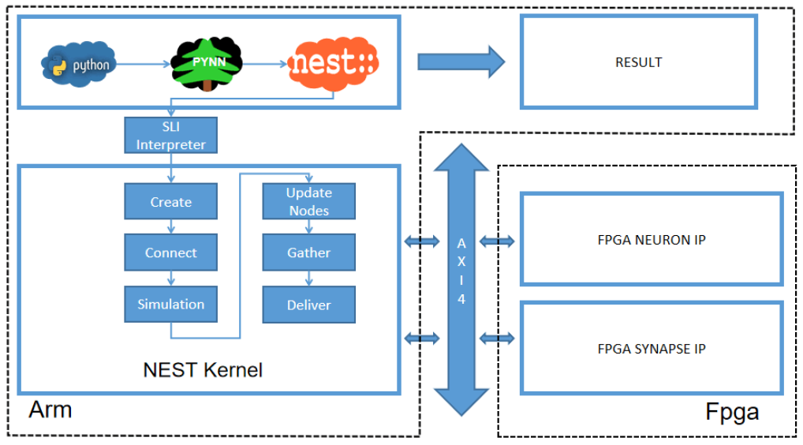
基于FPGA集群的类脑计算平台 Neuromorphic computing platform based on PYNQ cluster
Motivation
Implementation of unsupervised learning of image classification through spiking neuron network
Explore the design of Neuromorphic computing which large-scale and low-power systems through software/hardware co-design
Promote more people to develop FPGA-based Neuromorphic architecture research and learning through open source
Introduction
Spiking neuron network simulator NEST
SNN image classification
Neuron computing and STDP accelerator base on FPGA
MPI communication between PYNQ
https://github.com/clancylea/SNN-simulator-NEST_14.0-xilinx_FPGA_cluster

Slide 3
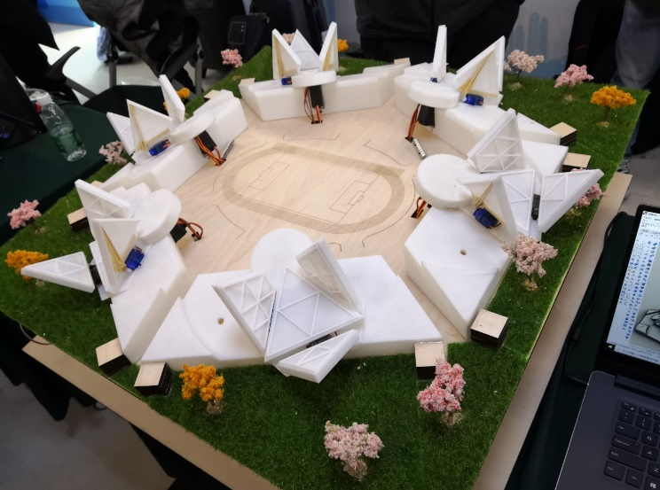
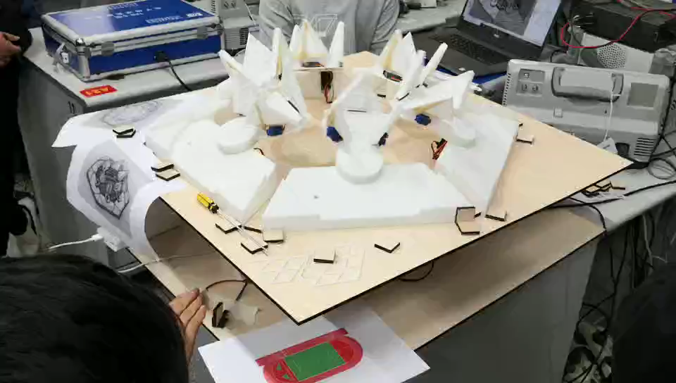
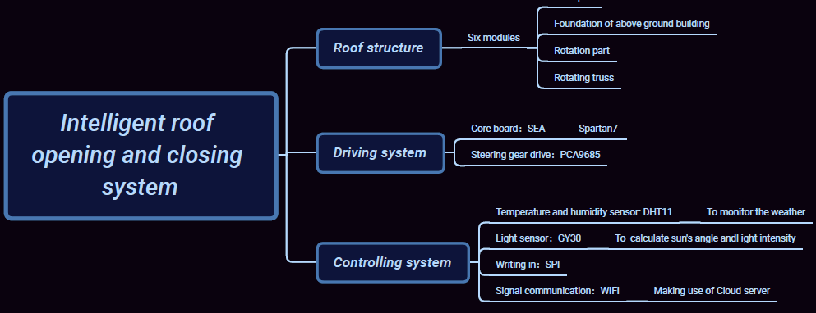
智能屋盖开合系统 Auto-controlled stadium system
Interdisciplinary design by student from civil-engineering and electronic engineering, good example FPGA for maker
Based on one spartan7 development kit
Motor control, temperature sensor, humidity sensor and light sensor
Remote manually control
Automatically open or close the roof according to the temperature, humidity and light
Video Demonstration

Slide 4
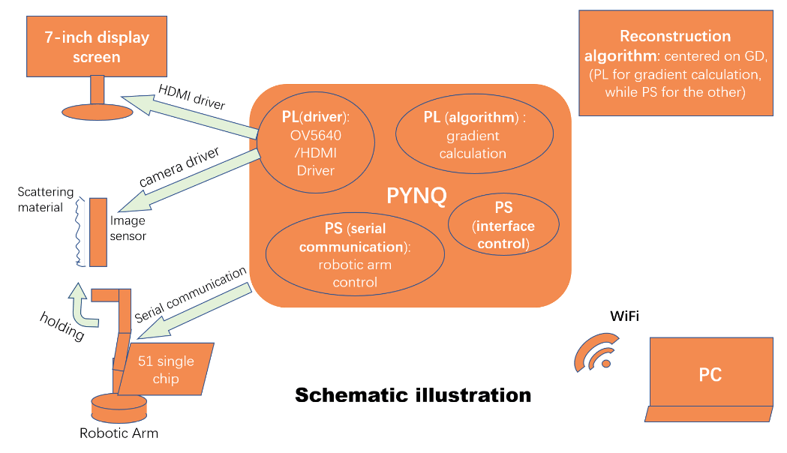
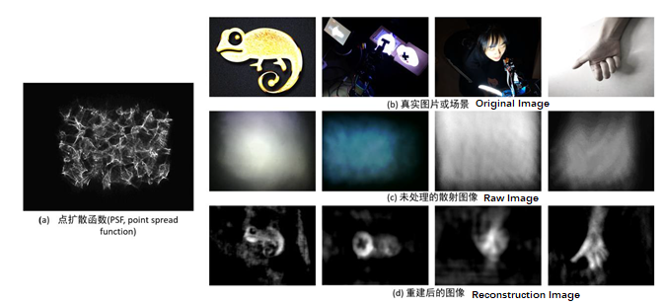
基于PYNQ的散色成像系统 An imaging system through scattering media base on PYNQ
System Architecture
PYNQ-Z2 board (for overall system control & reconstruction algorithm realization)
Lensless camera (replacing the lens in front of the sensor with scattering material
Robotic arm (holding the camera and adjusting the angle);
7-inch display screen (display the raw and reconstructed image)
Application prospect
Medical examination
Recognizing the traffic signs under haze weather condition

